Slide 1
Employee Data Analysis Using Excel
Name: S. Naveen Kumar
Register: user Id -asunm110312201260
Department: III Bcom (general )
College: D.R.B.C.C.C Hindu college , pattabiram

Slide 2
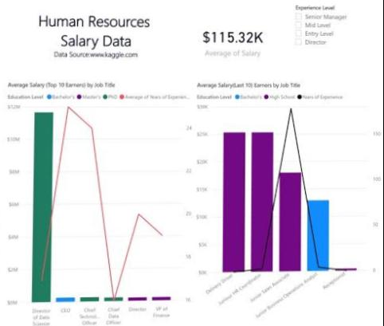

Project Title

Slide 3

PROJECT TITLE
Employee Type Analysis excel & Employee Salary analysis Using Excel

Slide 4

Ajenda
Problem statement
Project overview
End users
Our solution & preposition
Dataset discription
Modling approach
Result and Discussion
Conclusion

Slide 5

Problem statement
1. Calculating Average Salary: - To find the average salary of all employees, you can use the AVERAGE function in Excel. Simply select the range of salary values and apply the AVERAGE function to get the average salary. 2. Finding the Highest and Lowest Salaries: - To identify the employee with the highest and lowest salary, you can use the MAX and MIN functions in Excel. These functions will help you quickly determine the maximum and minimum salary values in the dataset. 3. Counting the Number of Employees: - If you want to know the total number of employees in your dataset, you can use the COUNT function. By selecting the range of employee names 4. Calculating Total Salary Expey expenses incurred

Slide 6

Project overview
1. Data Preparation - Organize your employee data in Excel with columns for employee names, departments, salaries, etc. - Ensure each row represents a unique employee with relevant information. 2. Calculating Key Metrics - Use functions like AVERAGE, MAX, MIN, COUNT, and SUM to calculate important metrics such as average salary, highest and lowest salaries, total salary expenses, and the number of employees. 3. Visualizing Data - Create charts or graphs to visualize the distribution of salaries, department-wise salary comparisons, or trends in salary changes over time. 4.Identifying Patterns and Discrepancies - Look for patterns in the data such as salary outliers, disparities between departments, or changes in sal

Slide 7
Who are the end users ‽
1.Human Resources (HR) Department - HR professionals use salary data analysis to evaluate compensation structures, make decisions on salary adjustments 2. Managers and Department Heads - Managers use salary data analysis to review departmental salary distributions, identify high-performing employees for rewards 3.Executives and Decision-Makers - Executives rely on salary data analysis to understand overall labor costs, assess 4. Employees* - Employees may also be end users of salary data analysis to understand salary benchmarks

Slide 8
Our solution & value prePosition
*Salary Analysis Solutions *Objective:* Gain insights from salary data to inform compensation decision *Steps: 1. *Data Preparation*: Collect, clean, and organize salary 2. *Data Visualization*: Use charts, graphs, and heat maps to illustrat 3.*Identifying Patterns*: Analyze distribution *Analysis Components 1. *Descriptive Analytics*: Understand current salary structures 2. *Diagnostic Analytics*: Identify disparities and trends.

Slide 9

Dataset Description
For this project, the dataset was sourced from the IBM Skills Build Dashboard, containing 20 features. The analysis focused on key features: 1. User ID: Unique employee identifier. 2. Name: Employee’s full name. 3.Gender: Employee gender, for diversity analysis.
4.Employment contract type (permanent, fixed-term, 5. Employee salary: employee salary based

Slide 10
Modelling Approach
In salary modeling, the steps typically involve: 1. *Data Collection* Gather relevant data on employee salaries and other related variables. 2. *Data Preparation* : Clean and preprocess the data to ensure accuracy and consistency. 3. *Feature Selection* Choose the variables that are most relevant to predicting salaries. 4. Model Building. Build a regression model that predicts salaries based on the selected features. 5. *Model Evaluation* Assess the model’s performance using metrics like mean squared error, R-squared value, or accuracy.

Slide 11
Modelling Approach
Salary Modeling Approach:A statistical method used to predict employee salaries based on factors such as:- Job title- Department- Location- Experience- EducationIt combines data analysis and machine learning techniques to:- Identify relationships between factors and salaries- Develop predictive models- Inform compensation decisionsCommon techniques used:- Regression analysis- Decision trees- Random forest- Neural networksGoal: Accurate salary predictions to support fair and competitive compensation prpactices.

Slide 12
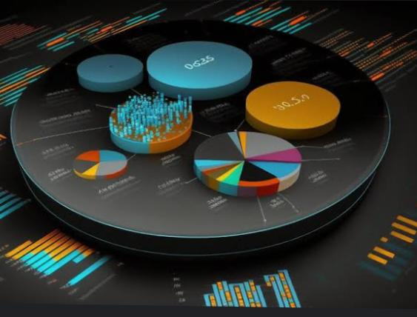
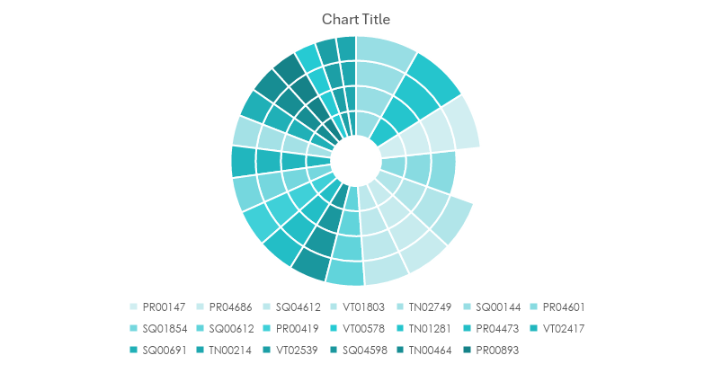
Results

Slide 13
Employee data salary

Slide 14
Discussion
When we talk about salaries, we are referring to the amount of money that an employee earns for their work within a specific period, usually monthly or annually. Salaries can vary based on factors such as the individual’s job role, experience, level of education, skills, and the industry they work in.
Employers determine salaries based on various considerations, including market rates, the organization’s budget, and the employee’s performance. It’s essential for organizations to establish fair and competitive salary structures to attract and retain talented employees.
Salary discussions often involve negotiations during job offers, performance reviews, promotions, or when addressing pay discrepancies. Understanding salary components like base salary, bonuses, benefits, and incentives is crucial for both employees and employers to ensure transparency and fairness in compensation practices.

Slide 15
Conclusion
When analyzing employee salary data, it’s crucial to consider various factors such as job roles, experience levels, education, and industry standards. By examining this data, organizations can ensure fair and competitive compensation structures, identify any disparities, and make informed decisions regarding salary adjustments, promotions, and recruitment strategies. Conducting thorough analysis of employee salary data helps in maintaining transparency, equity, and employee satisfaction within the organization.
In concluding the analysis of employee salary data, it is evident that a comprehensive examination of various factors such as job roles, experience, education, and industry standards is essential. This analysis aids in the establishment of equitable and competitive compensation structures within organizations. By leveraging this data, companies can address any discrepancies, ensure transparency, and make well-informed decisions regarding salary adjustments, promotions, and talent acquisition strategies. Ultimately, a thorough analysis of employee salary data is vital for fostering fairness, employee satisfaction, and organizational success. If you have any more questions or need further insights on this topic, feel free to ask!

